Slide 1
Solvents
by
Dr. A. Stella Shalini
Assistant Professor,
Department of Chemistry,
St. Joseph’s College,
Trichy-2

Slide 2
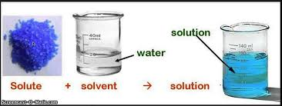
Introduction
Substance - power of dissolving other
substances

Slide 3
Water as Universal solvent
Water is an excellent solvent.
High dielectric constant & high ionizing
capacities
Reduces forces of electrostatic attraction binding
the charged ions in solid electrolytes.

Slide 4
Water as Universal solvent (contd.)
It is neutral, odourless, non-toxic and non- poisonous. So handled safely.
Due to these characteristics, water serves as the most useful solvent.

Slide 5
How water dissolves salt?

Slide 6
Non aqueous solvents
They have sizeable dielectric constants and high
ionizing capacities like water.
(i) liquid ammonia
(ii) liquid SO₂
(iii) Anhydrous HF
(iv) Anhydrous H₂SO₄
(v) liquid N₂O₄

Slide 7
Classification of solvents:
Protic and Aprotic solvents
Acid solvents, basic solvents and amphiprotic
solvents
(3) Ionising and Non-ionising solvents

Slide 8
Thank You

